Slide 1
Automated atlas-based analysis of histological section images from rodent models of normal and diseased brains
Sharon Yates
Institute of Basic Medical Sciences
University of Oslo
PhD defence

Slide 2
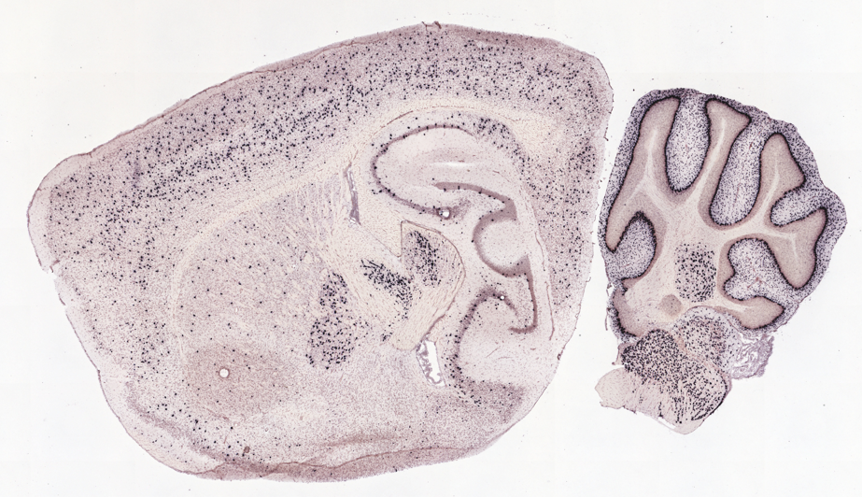
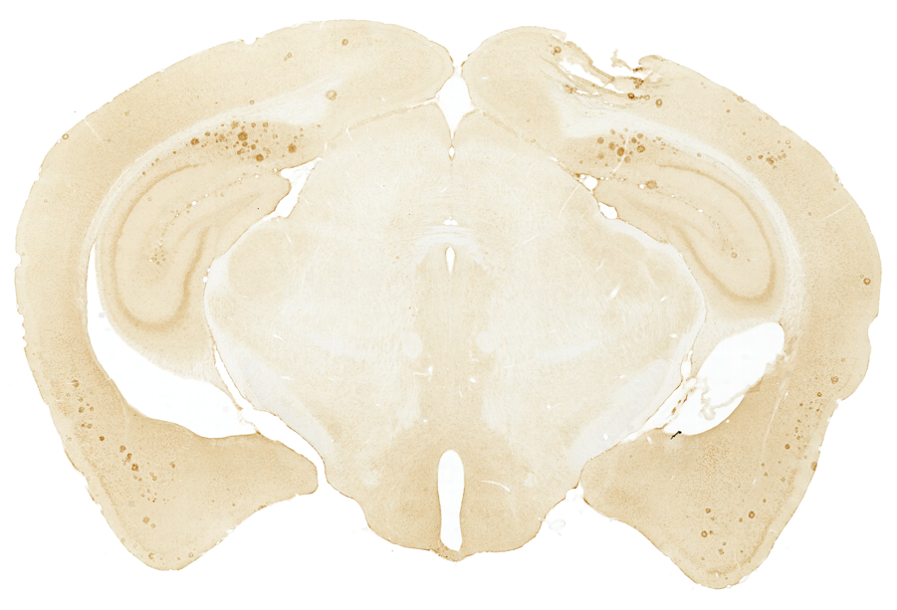
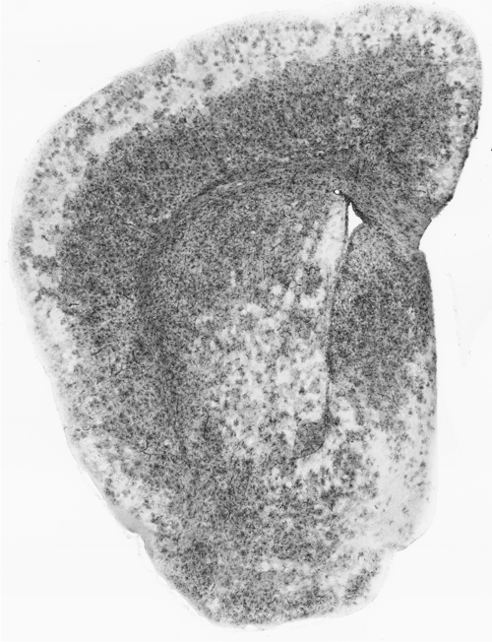
Aims of the thesis
Equip researchers with user-friendly and semi-automated tools that support high-throughput analysis of histological section images from rodent brains.
Use these tools for discovery-based research.
Notes:
The aims of my projects were to 1. and 2. The discovery-based research would be performed as part of collaborative projects with other researchers.

Slide 3
Articles in the thesis
Paper I: Yates SC, Groeneboom NE, Coello C, Lichtenthaler SF, Kuhn PH, Demuth HU,Hartlage-Rübsamen M, Roßner S, Leergaard T, Kreshuk A, Puchades MA, Bjaalie JG (2019). QUINT: Workflow for quantification and spatial analysis of features in histological images from rodent brain. Front Neuroinform 13:75. DOI: 10.3389/fninf.2019.00075
Paper II: Groeneboom NE, Yates SC, Puchades MA and Bjaalie JG. Nutil: A Pre- and Post-processing Toolbox for Histological Rodent Brain Section Images (2020). Front. Neuroinform 14:37. DOI: 10.3389/fninf.2020.00037
Paper III: Gurdon B*, Yates SC*, Csusc G, Groeneboom N, Hadad N, Telpoukhovskaia M, Ouellette A, Ouellette T, O’Connell K, Singh S, Murdy T, Merchant E, Bjerke I, Kleven H, Schlegel U, Leergaard T, Puchades M, Bjaalie J, Kaczorowski C (2023). Detecting the effect of genetic diversity on brain composition in an Alzheimer’s disease mouse model. BioRxiv. DOI: 10.1101/2023.02.27.530226
* Shared first authorship

Slide 4
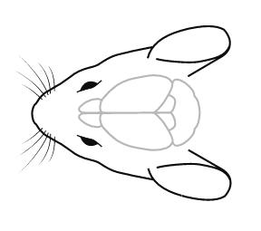
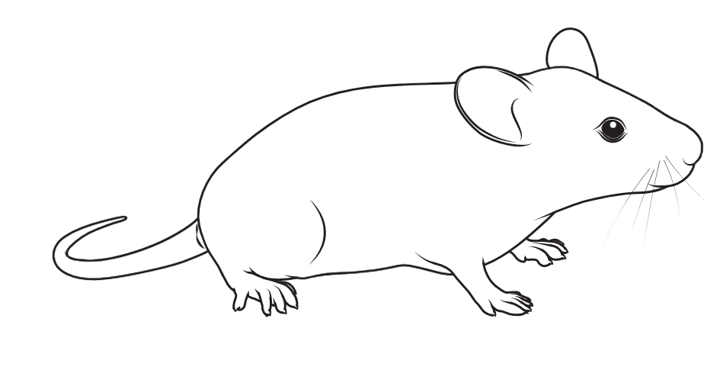
Research using rodent models
Provide information about the brain in health and disease
Similarities in structure and function between species mean they are an alternative for exploring the human brain
Normal models
Explore connectivity, spatial distribution and density of cells in healthy tissue
Reference datasets
Quantitative data used to feed computational models
Transgenic models
Mimic pathogenic mechanisms of disease
Assess disease progression by quantifying cells, pathogenic markers-of-disease
Effects of interventions
Anatomical differences relative to normal mice
Picture source: scidraw.io
Notes:
1. To give a bit of background, rodent models are commonly used to learn more about the brain in health and disease, which is possible due to similarities in structure and function between species.
3. One of the great things about rodent models enable studies that would be impossible to perform in human subjects due to ethical but also time restrictions.

Slide 5
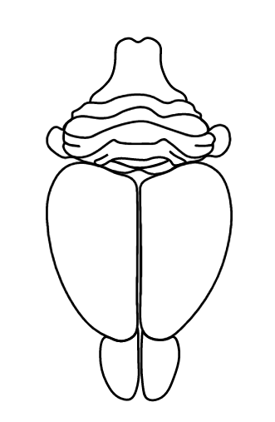
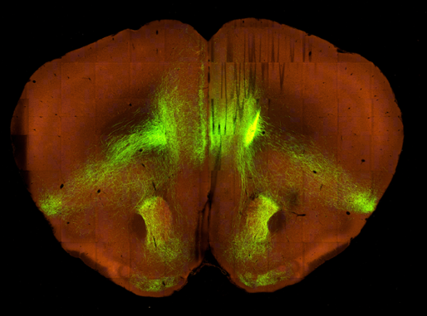
Quantify features in rodent brains
Histological brain sections are widely used to support quantification
Brain is sectioned, labelled and imaged under the microscope
immunohistochemistry
in situ hybridisation
Connectivity
Picture source: scidraw.io
Images from Allen Institute
Notes:
There are lots of different ways to explore these models.
A common approach used for quantification is to section, label and image the brain to produce a series of histological section images.

Slide 6
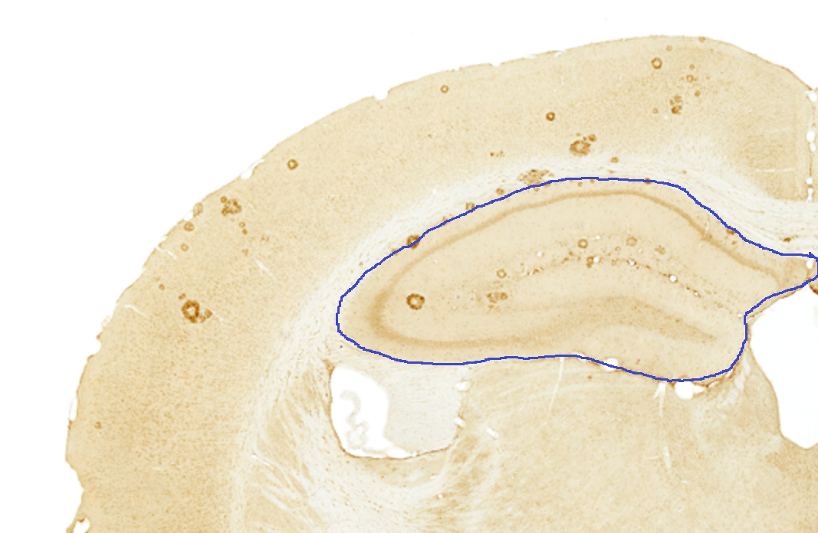
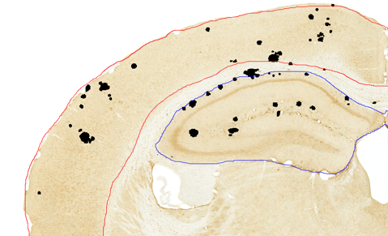
How to quantify the labelling?
Manual counting
Stereology
Segmentation
Limitations
manual, time consuming
access to microscope and sterelogy equipment
Does not support:
brain-wide exploration
cross-study comparison
Notes:
Once you have series of histological section images, how do you quantify the labelling?
The traditional method relies on manual delineation of brain regions based on book atlases and anatomical expertise,
- Or quantified by stereology, which is considered the gold standard method and involves systematic sampling of objects within the region with extrapolation to the whole.
- A more modern approach is to extract the objects by segmentation with an image analysis software such as ImageJ. which can either be by intensity thresholding or more sophisticated algorithms such as supervised machine learning or deep neuronal networks.

Slide 7
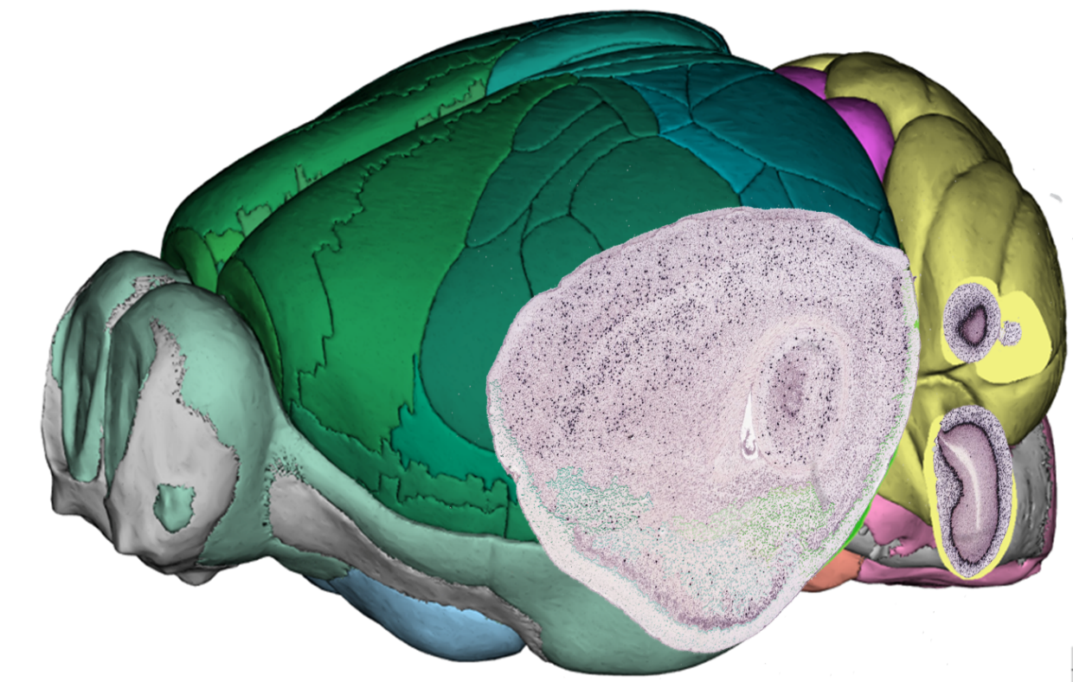
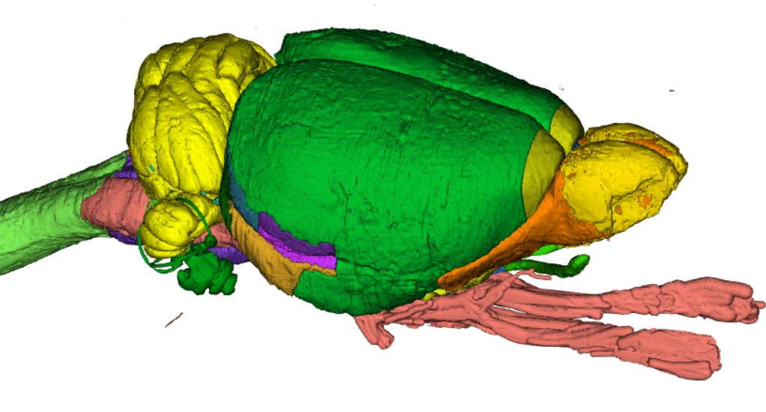
Reference Atlases of the Brain
Reference atlases enable registration to volumes and sections cut at arbitrary angles
Allen Mouse Brain Atlas
Common Coordinate Framework v3
Waxholm Atlas of the Sprague Dawley Rat

Slide 8
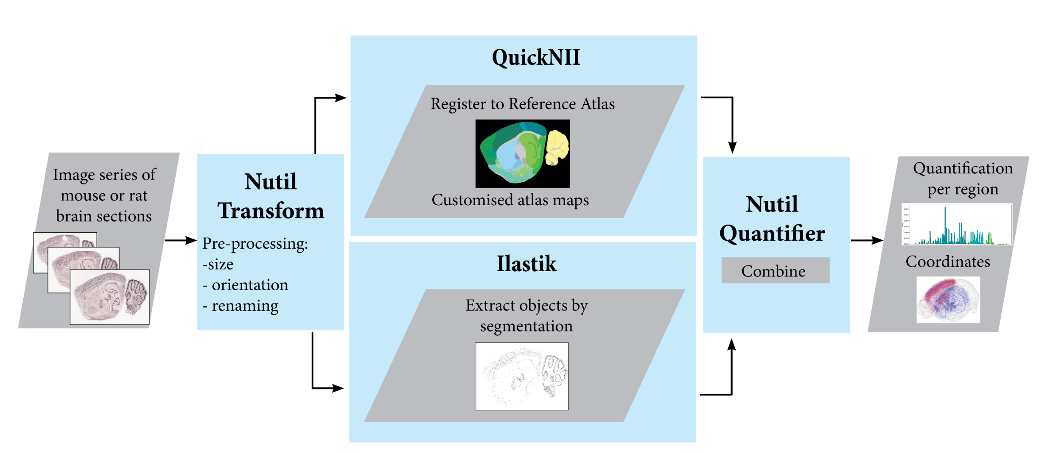

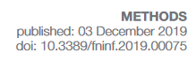
Paper 1
QUINT: Workflow for Quantification and Spatial Analysis of Features in Histological Images from Rodent Brain
Notes:
This lead to the development of the QUINT workflow for quantification and spatial analysis of features in histological sections. QUINT combines 3 desktop tools: QuickNII, ilastik and Nutil.
QuickNII enables the registration of histological brain sections to a 3D reference atlas to generate customized atlas-planes.
Ilastik enables the extraction of labelled objects from the images by segmentation based on supervised machine learning algorithms.
And Nutil, which was developed in house and supports both the pre-processing steps, and the final quantification step based on the customized atlas-planes and segmentations.
The workflow was published in frontiers of neuroinformatics in 2019 with exemplification in a mouse model of Alzheimer’s disease.

Slide 9
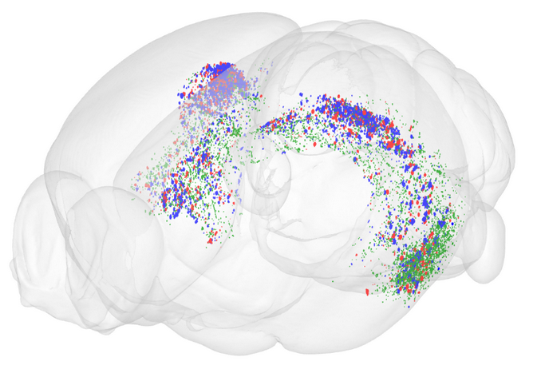
Use case
Beta-amyloid
Image of result
Point clouds visualised in the Meshview Atlas Viewer
Co-localisation study for three beta-amyloid species
Notes:
Differential distribution of three beta-amyloid species

Slide 10
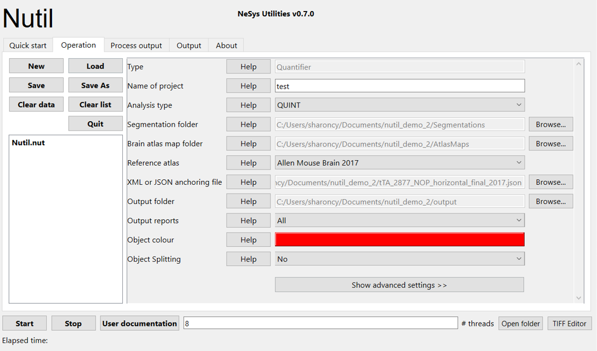

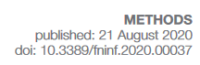
Paper 2
Nutil: A Pre- and Post-processing Toolbox for Histological Rodent Brain Section Images
Select Reference Atlas
Support for:
Connectivity data
Hemibrain sections
Additional atlases
Navigate to:
Segmentation folder
Atlas map folder
Output folder
Objects to quantify
Small or big objects?
Notes:
At this point the Nutil software was relatively crude and not very user-friendly. So for the next part of the project, we improved the Nutil software considerably by adding a graphical user interface. We also established contact with prospective QUINT users through github and various dissemination events to find out about requirements.
- As a result we implemented support for connectivity data, hemibrain sections, additional atlases, as well as other features such as minimum object size.

Slide 11
Paper 2 results
Focus on validation
First ground truth dataset

Slide 12
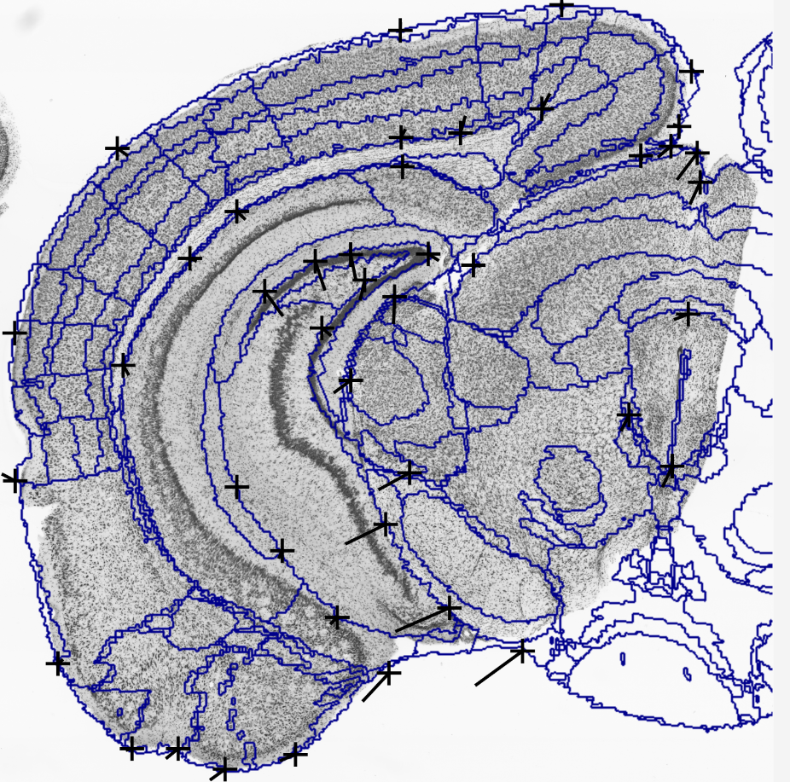
Paper 3
Incorporate two new software in the workflow
VisuAlign and QCAlign

Slide 13
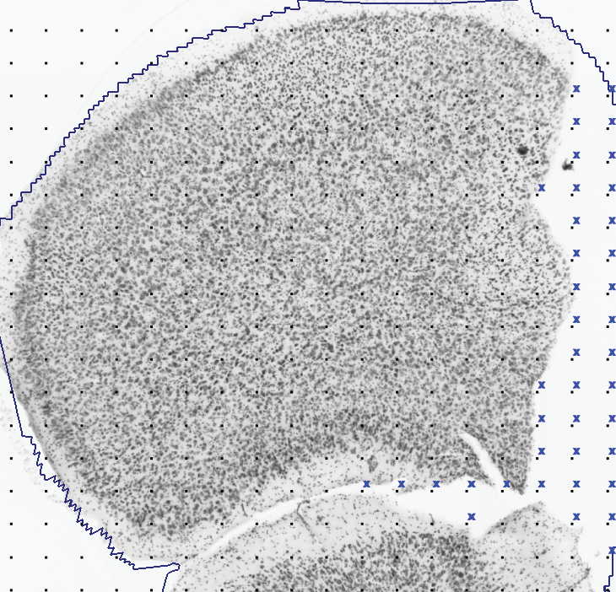
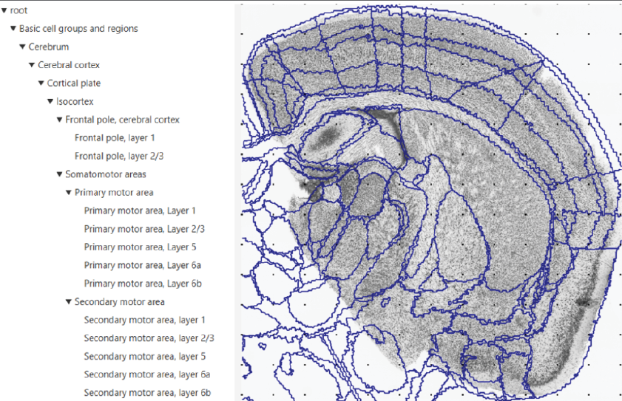
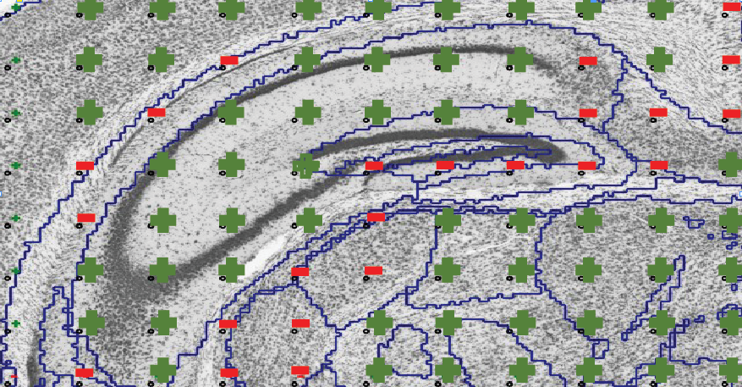
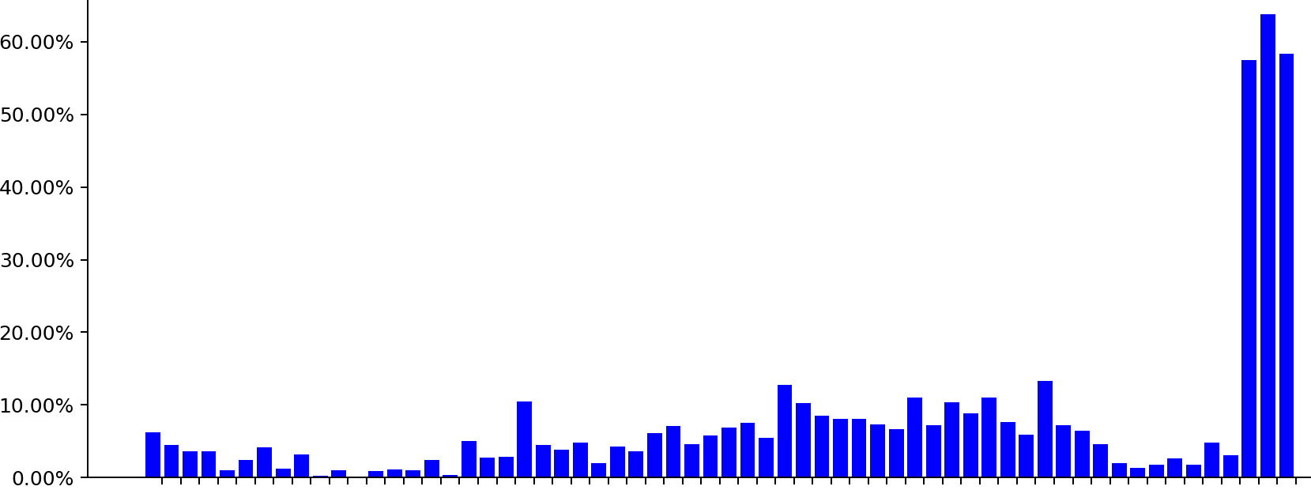
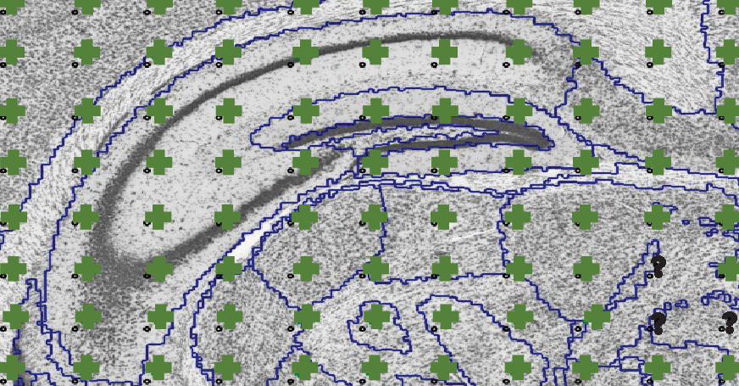
Paper 3
1. Screen sections for damage
2. Create customized regions
3. Evaluate the atlas-registration
QuickNII only
QuickNII and VisuAlign
Anterior sections
Posterior sections
Gurdon et al, 2023. DOI: 10.1101/2023.02.27.530226

Slide 14
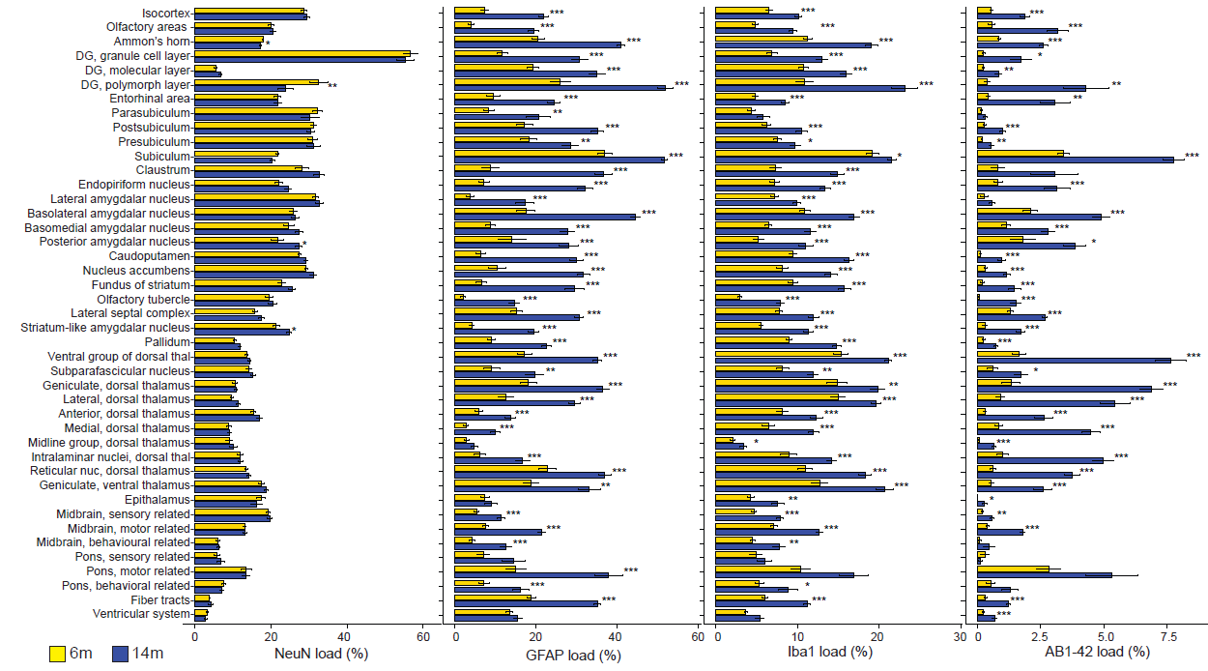
Paper 3
Neurons
Astrocytes
Microglia
Beta-amyloid

Slide 15
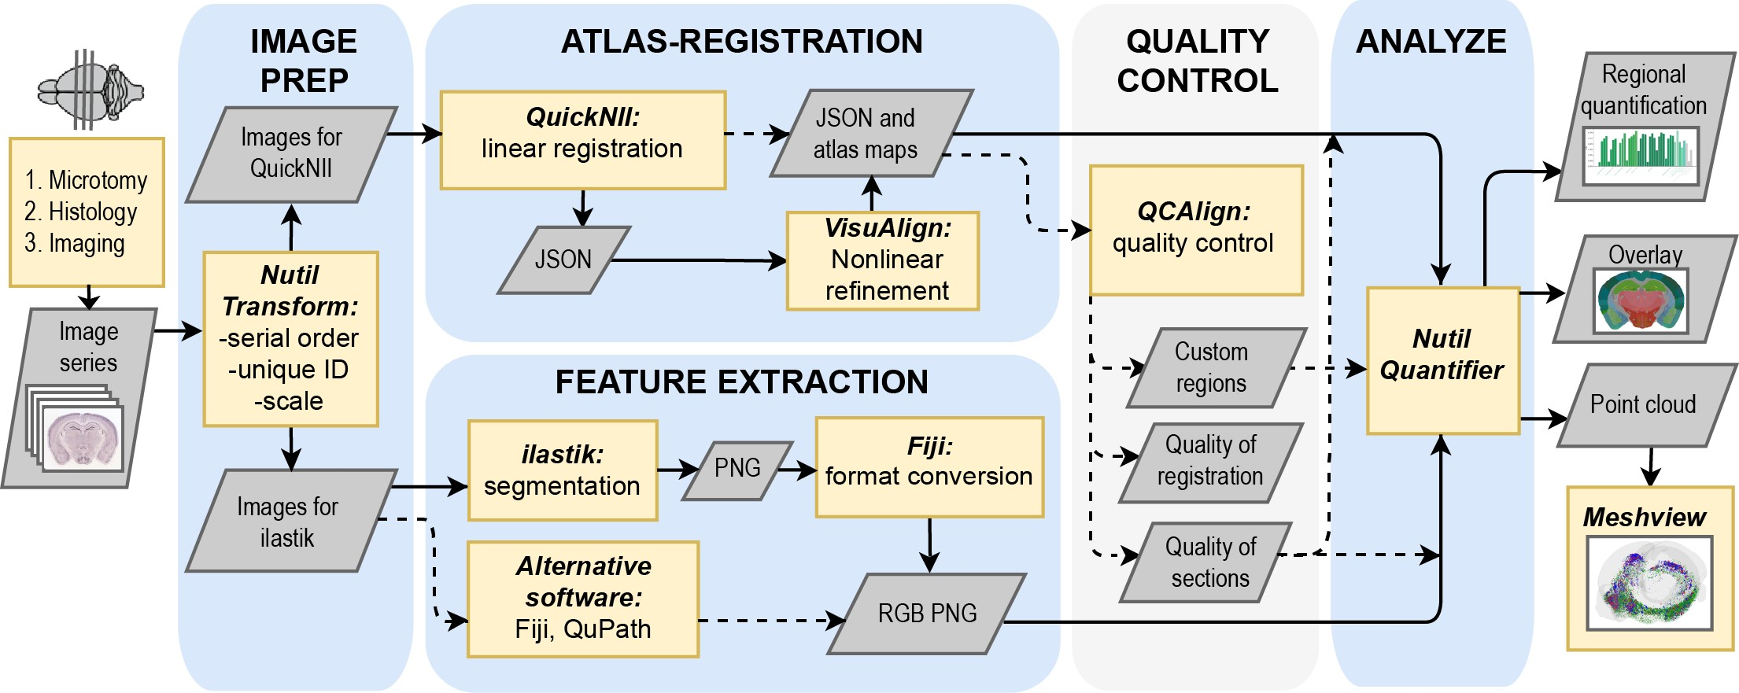
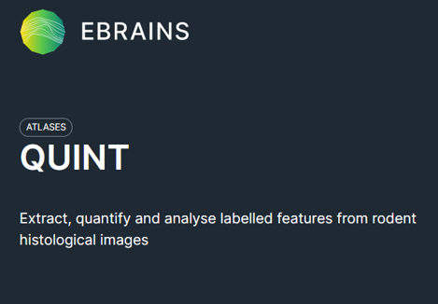
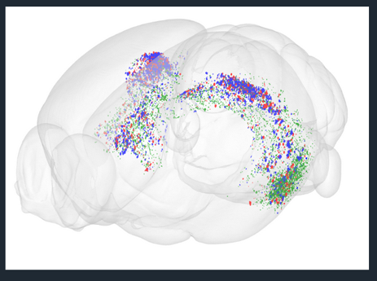
QUINT workflow for spatial analysis
ebrains.eu/service/quint
Yates et al, 2020. DOI:10.3389/fninf.2019.00075

Slide 16
Nutil software
The Nutil software is a pre- and post-processing toolbox for histological images
Transform for image preparation (downscale, rotate, rename, etc)
Quantifier for spatial analysis
Quantifier
Support for:
Object counting
Regional coverage
Connectivity data
Hemibrain sections
CCFv3 and WHS atlas
Many optional features
Select Reference Atlas
Navigate to:
Segmentation folder
Atlas map folder
Output folder
Objects to quantify
Small or big objects?
Groeneboom et al, 2019. DOI: https://doi.org/10.3389/fninf.2020.00037
Notes:
Use it for the image preparation step (downscale, rotate, rename, etc). Also use it for the spatial analysis based on the results of the atlas-registration and the segmentations from the ilastik software.

Slide 17
Nutil results
Reports with counts and regional coverage per reference atlas region
Bjerke et al, 2020. DOI: 10.1016/j.isci.2020.101906
Notes:
Used it to show complimentary patterns of parvalbumin and calbidin cells across the mouse brain.

Slide 18
Nutil results
Gurdon et al, 2023. DOI: 10.1101/2023.02.27.530226
Neurons
Astrocytes
Microglia
Beta-amyloid
Results in customised regions
Regional coverage in 44 regions
Results compared across AD-BXD mice at different ages.
Notes:
In a recent study, the workflow was used to calculate regional coverage in 44 customized regions in a new mouse model of AD at two different ages.

Slide 19
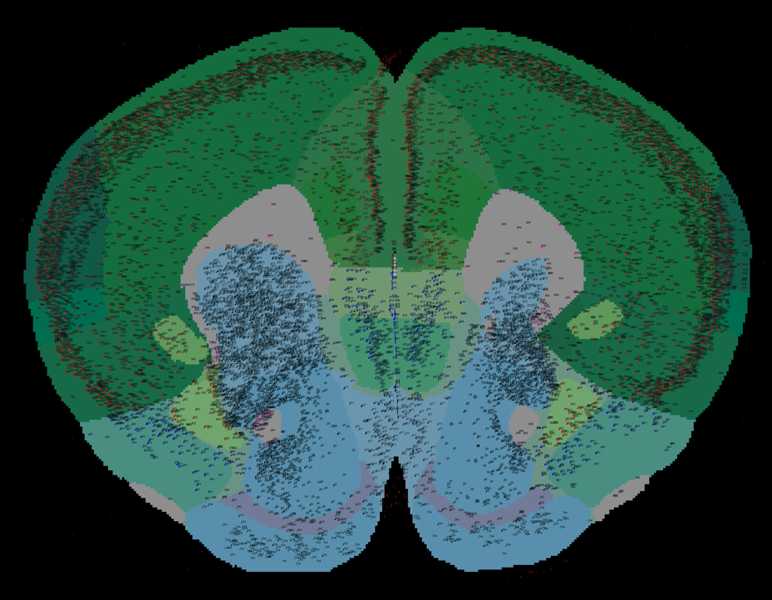
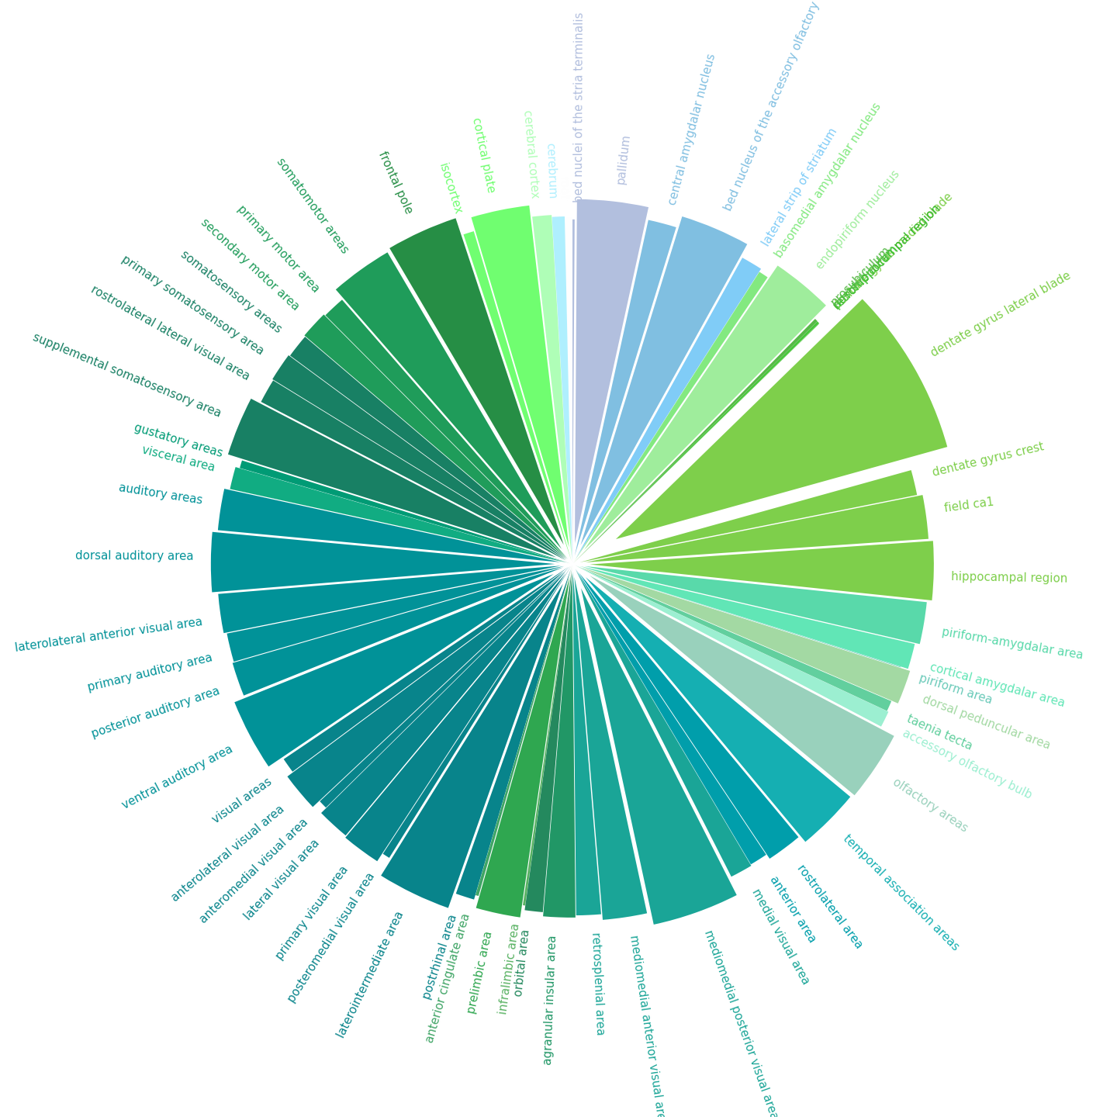
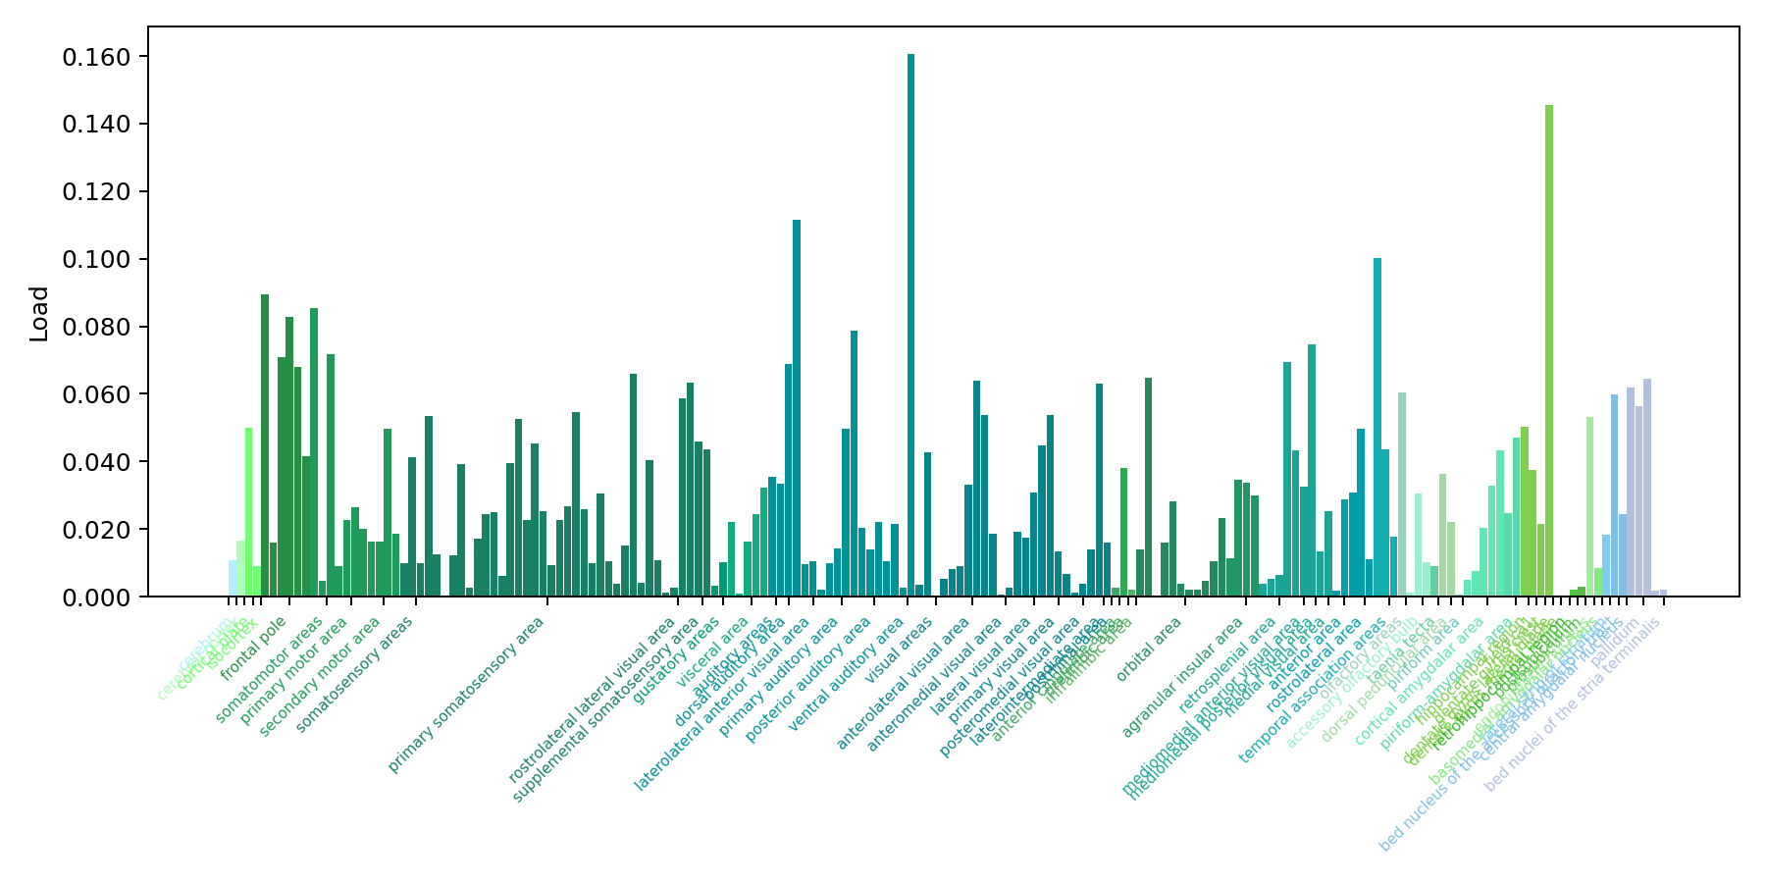
Nutil results
Point clouds visualised in the Meshview Atlas Viewer
Overlay images
Automatic plotting
Co-localisation study for three beta-amyloid species
Yates S.C. et al, 2019. DOI: 10.3389/fninf.2019.00075

Slide 20
QCAlign software
supports QUINT analysis for high-throughput studies
1. Screen sections for damage
2. Create customized regions
3. Evaluate the atlas-registration
QuickNII only
QuickNII and VisuAlign
Anterior sections
Posterior sections
Gurdon et al, 2023. DOI: 10.1101/2023.02.27.530226

Slide 21

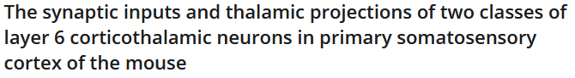

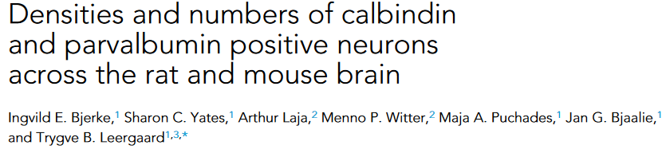

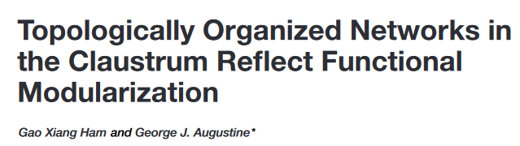
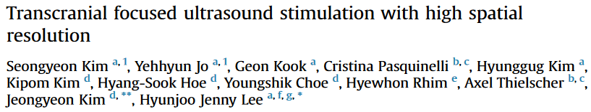


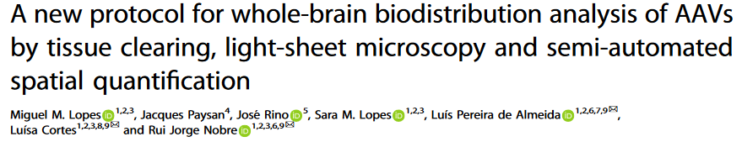

QUINT analysis in the literature
Quantify cells and receptors
Analyse connectivity data
Localise probe tracts
Localise microemboli
Analyse tissue clearing data
Notes:
To date, the QUINT workflow has been used by a number of research groups ..

Slide 22
Community-driven development
Communication with user community:
EBRAINS support
Github
Voucher projects
Request for new functionality
QCAlign tool
Requests relating to atlases, coordinates, etc.
External users have helped us identify and fix bugs.
support@ebrains.eu
Notes:
Use it for the image preparation step (downscale, rotate, rename, etc). Also use it for the spatial analysis based on the results of the atlas-registration and the segmentations from the ilastik software.

Slide 23
Acknowledgements
NeSys tools development team
Sharon Yates
Nicolaas Groeneboom
Gergely Csúcs
Harry Carey
Ingvild Bjerke
Dmitri Darine
Trygve Leergaard
Maja Puchades
Jan Bjaalie
Collaborators
Ilastik team, HDB
Brianna Gurdon, JAX
Catherine Kaczorowski, JAX
Input from many software users
This project has received funding from the European Union’s Horizon 2020 Research and Innovation Programme under Grant Agreement No. 720270 (HBP SGA1) and No. 785907 (HBP SGA2) No. 945539 (Human Brain Project SGA3)
Notes:
I would like to acknowledge
The current atlas development team
Atlas development contributors
And our collaborators

Slide 24
Thank you

